Slide 1
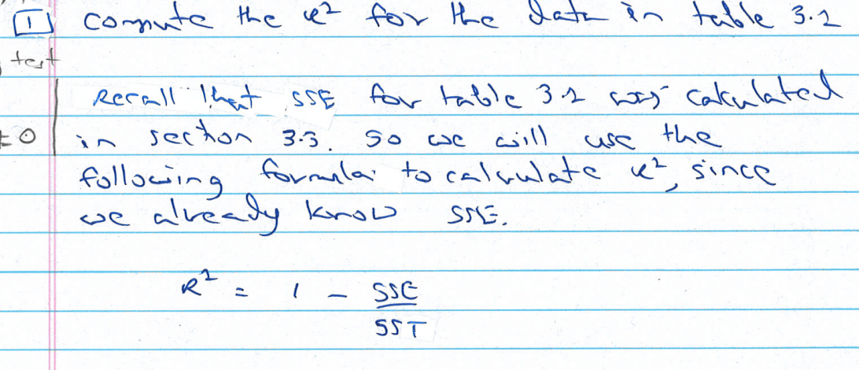

Slide 2
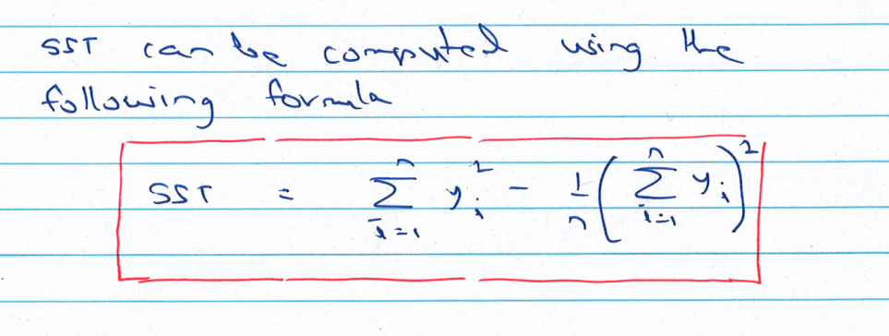

Slide 3
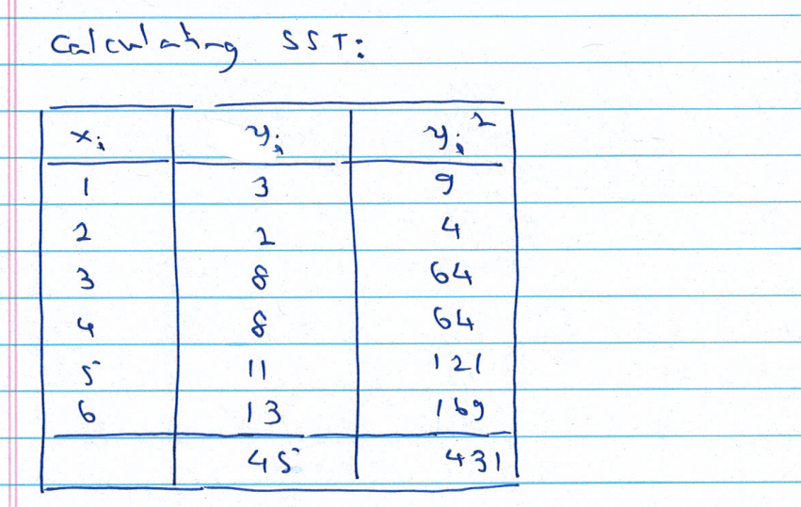

Slide 4
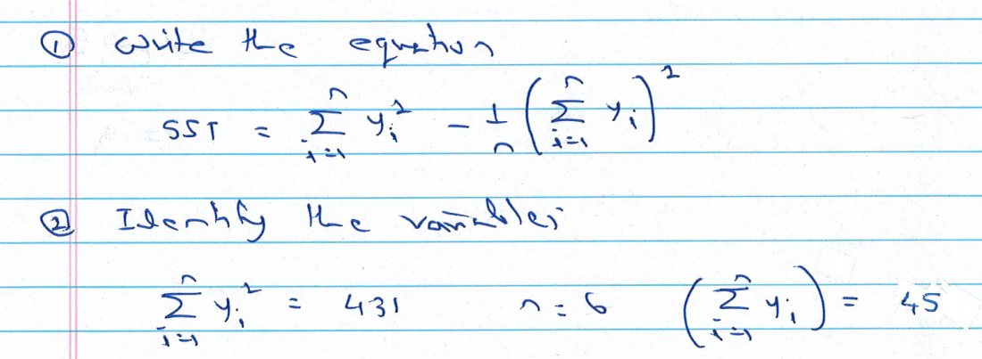

Slide 5
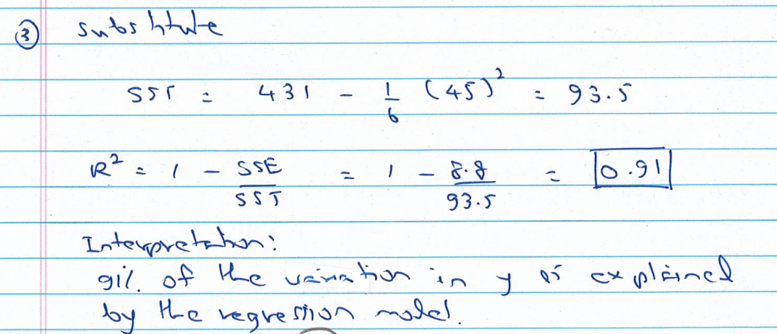

Slide 6
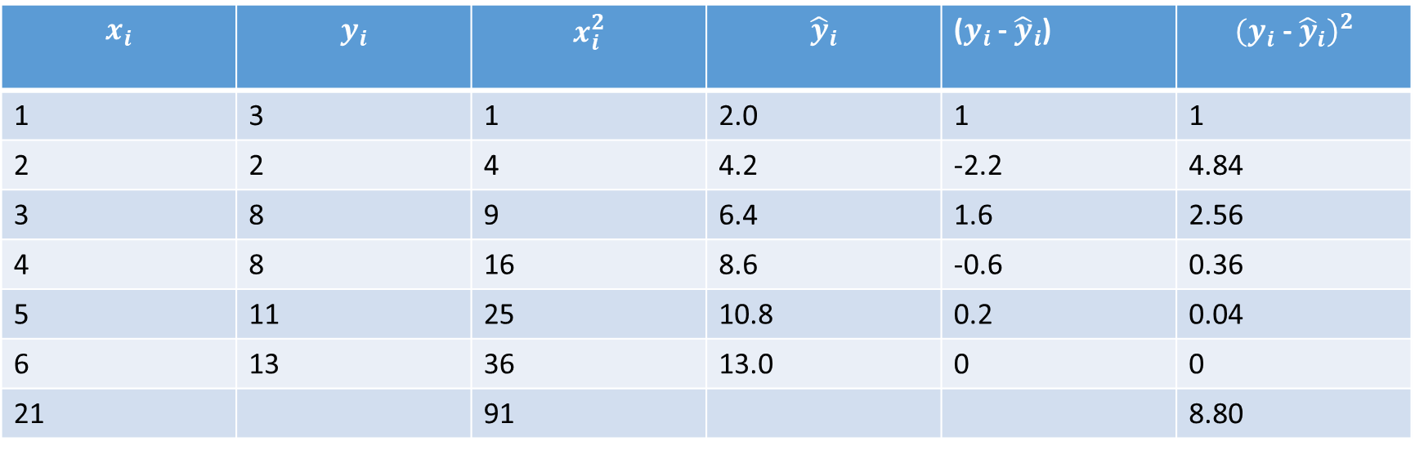
Answer
$$x_{i}$$ | $$y_{i}$$ | $$x_{i}^{2}$$ | $${\hat{y}}_{i}$$ | ($y_{i}$ - ${\hat{y}}_{i}$) | $${(y_{i}\text{ − }{\hat{y}}_{i})}^{2}$$
1 | 3 | 1 | 2.0 | 1 | 1
2 | 2 | 4 | 4.2 | -2.2 | 4.84
3 | 8 | 9 | 6.4 | 1.6 | 2.56
4 | 8 | 16 | 8.6 | -0.6 | 0.36
5 | 11 | 25 | 10.8 | 0.2 | 0.04
6 | 13 | 36 | 13.0 | 0 | 0
21 |  | 91 |  |  | 8.80

Slide 7
Using R
Calculate SST and SSE using “anova” function in R
Calculate R-square directly using “summary” function.

Slide 8
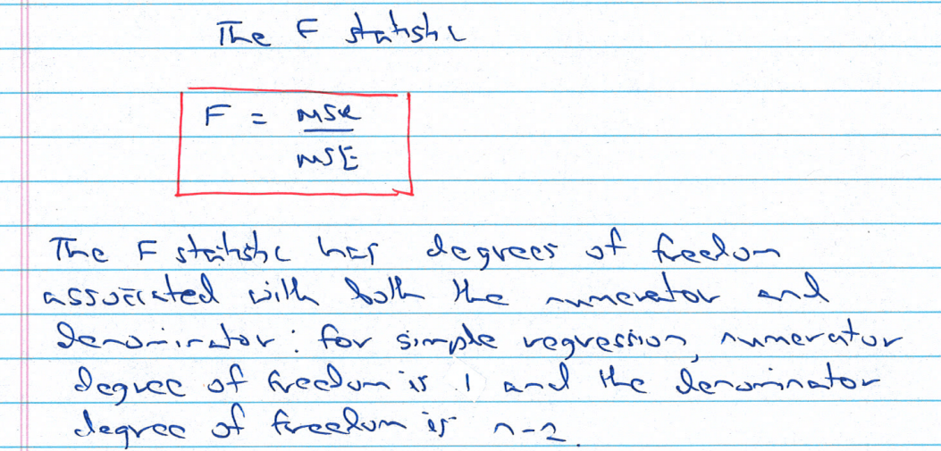

Slide 9
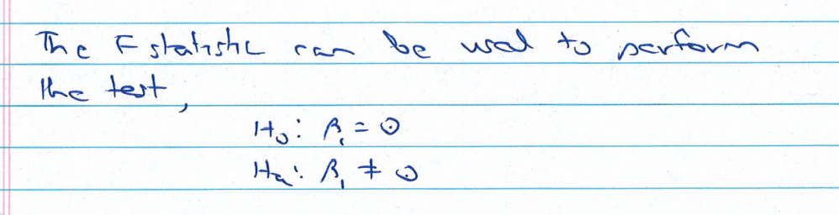

Slide 10
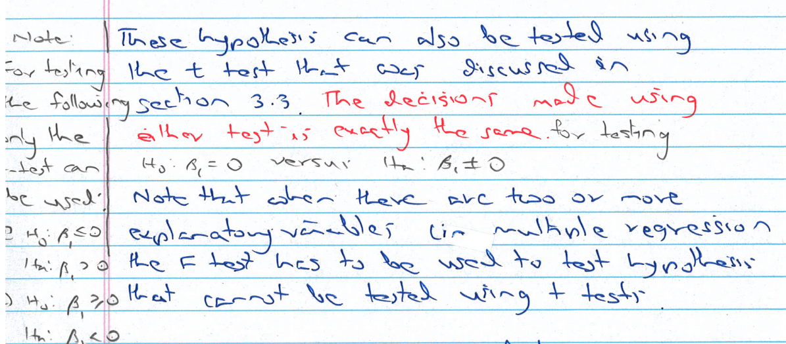

Slide 11
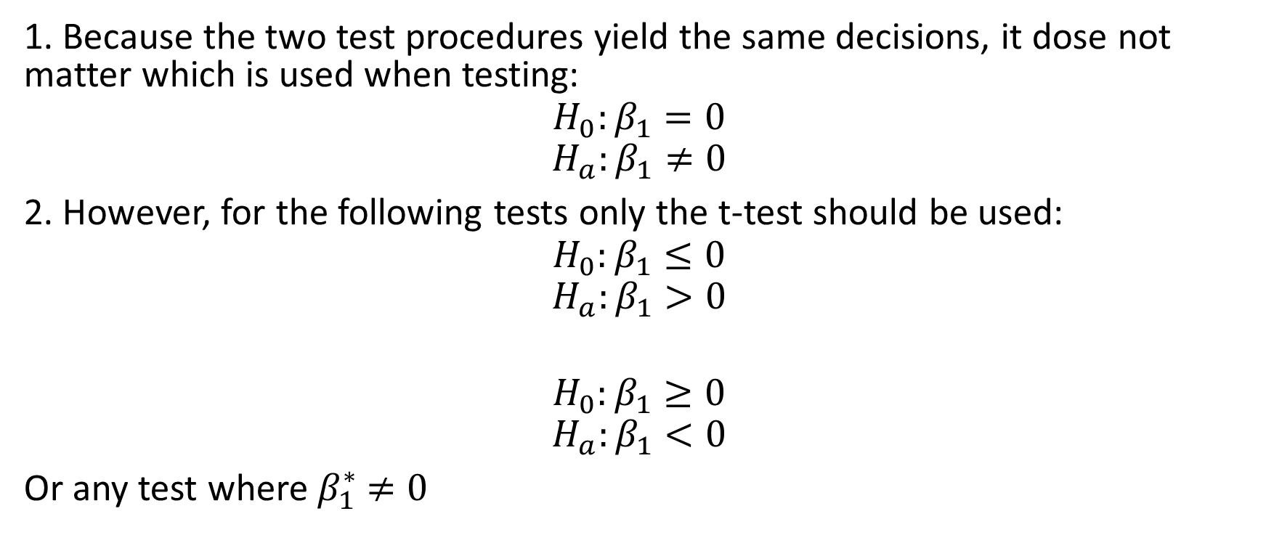
Note
1. Because the two test procedures yield the same decisions, it dose not matter which is used when testing:
$$H_{0}:β_{1}=0$$
$$H_{a}:β_{1}≠0$$
2. However, for the following tests only the t-test should be used:
$$H_{0}:β_{1}≤0$$
$$H_{a}:β_{1}>0$$
$$H_{0}:β_{1}≥0$$
$$H_{a}:β_{1}<0$$
Or any test where $β_{1}^{∗}$ $≠0$

Slide 12
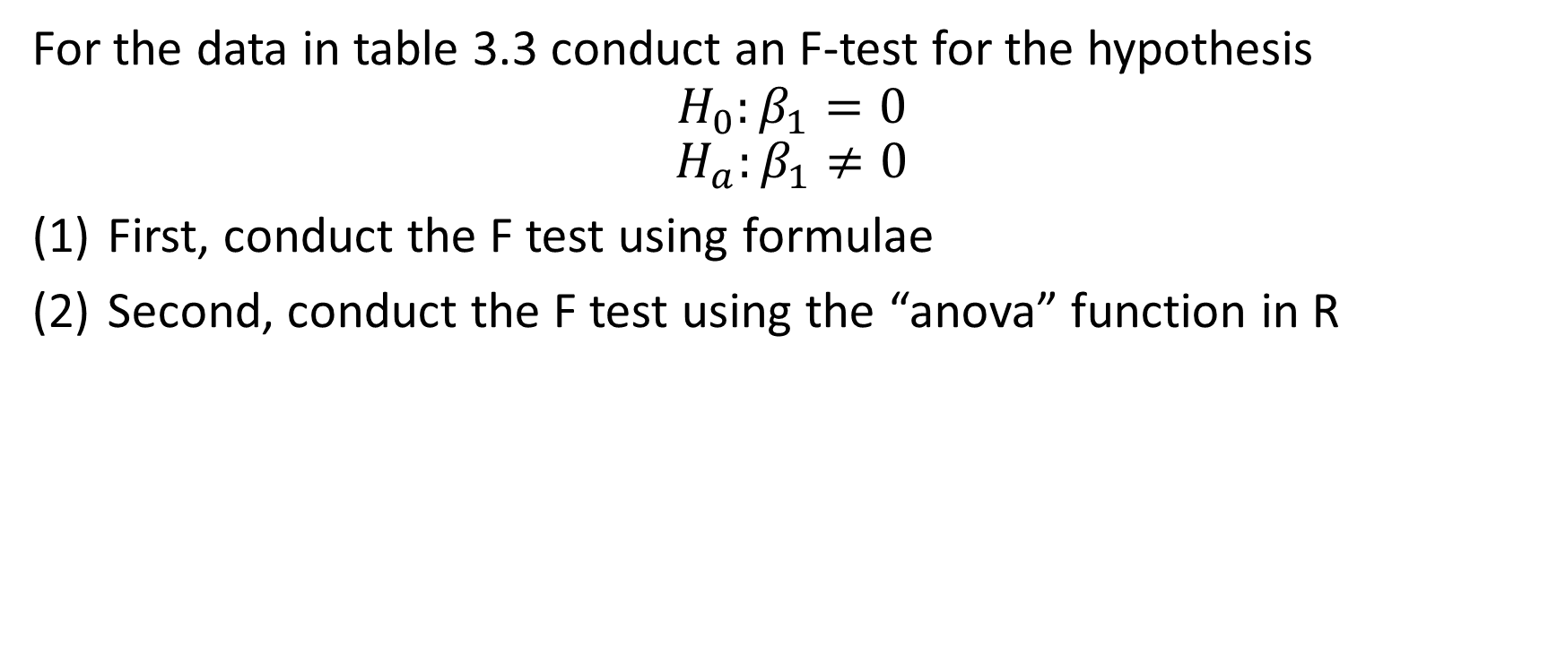
Question
For the data in table 3.3 conduct an F-test for the hypothesis
$$H_{0}:β_{1}=0$$
$$H_{a}:β_{1}≠0$$
First, conduct the F test using formulae
Second, conduct the F test using the “anova” function in R

Slide 13
